Slide 1

Employee Management System
Presented by
Tharun kumar CH
Batch No : 450
Innomatics Research Labs – Dilsukhnagar

Slide 2

Agenda
Business Problem Statement
Objective of the Project
ER Diagram
Tables
Key analysis questions
SQL query results with screenshots or summaries
Final business insights
Conclusion

Slide 3

Business Problem
Many organizations struggle to manage employee information efficiently because their data is scattered across spreadsheets, files, or different systems.
HR teams find it difficult to track employee details, job roles, salaries, qualifications, leave records, and payroll information in one place.
Due to this:
1. Payroll calculations become time-consuming and error-prone
2. Leave tracking is inconsistent
3. Getting department-wise reports or employee insights is difficult
4. Data updates in one place are not reflected elsewhere, leading to inconsistencies

Slide 4

Objective of the Project
Main Objective:
To design and implement a centralized Employee Management System that efficiently stores, manages, and retrieves employee-related data, helping the organization streamline HR operations and maintain accurate records.
Key Points:
1. To store employee information such as Personal details, job roles, and departments in a structured database.
2. To manage salary, bonus, and payroll data accurately using relational tables.
3. To track employee qualifications and leave records for better workforce management.
4. To ensure data integrity and consistency using primary keys, foreign keys, and cascading actions.
5. To enable easy querying and reporting for HR insights like payroll analysis, leave trends, and department-wise roles.
6. To reduce manual effort and errors in HR data management.

Slide 5
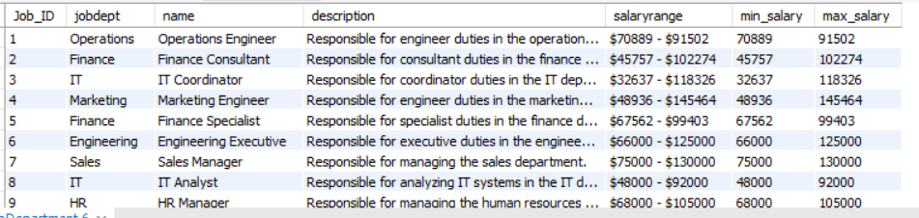
Tables
Job Department
This Table includes:
1. Job_ID
2. Job dept
3. Dept name
4. Job description
5. salary range

Slide 6
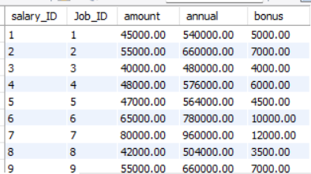
Tables
Salary Bonus
This Table includes:
1. Salary_ID
2. Job_ID
3. Amount
4. Annual
5. Bonus

Slide 7
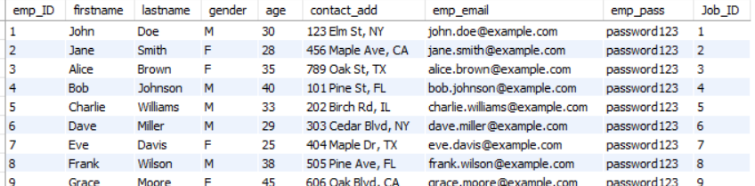
Tables
Employee details
This Table includes:
1. Emp_ID
2. Firstname and Lastname
3. Gender
4. Age
5. Address
6. Employee_mail
7.Emp_pass
8. Job_ID

Slide 8
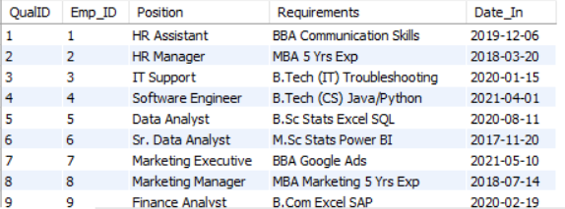
Tables
Qualification details
This Table includes:
1. Qualification ID
2. Emp ID
3. Position
4. Requirements
5. Date In

Slide 9
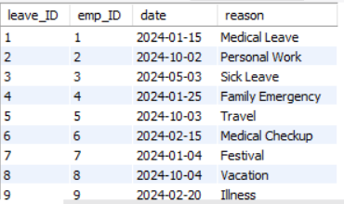
Tables
Leave details
This Table includes:
1. Leave ID
2. Emp ID
3. Date
4. Reason for leave

Slide 10
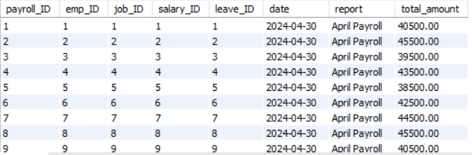
Tables
Leave details
This Table includes:
1. Payroll ID
2. Emp ID
3. Job ID
4. Salary ID
5. Leave ID
6. Date
7. Report
8. Total Amount

Slide 11
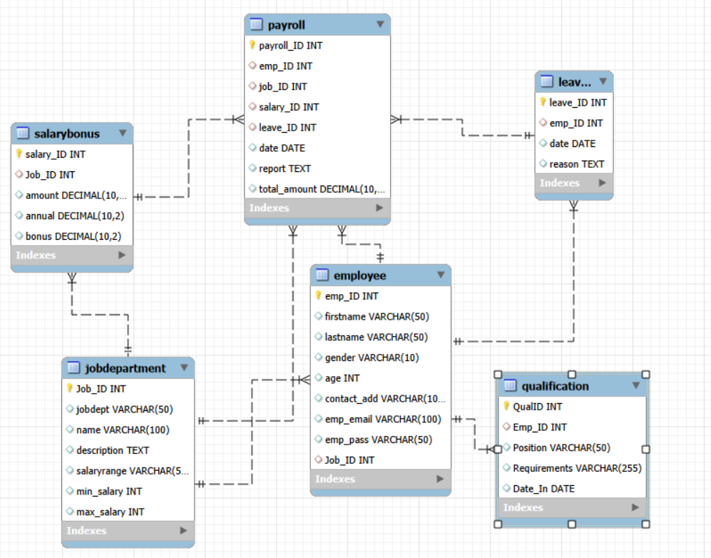
ER Diagram

Slide 12
Cardinality
Parent Table | Child Table | Relationship
Job Department | Employee | 1 : N
Job Department | SalaryBonus | 1 : N
Employee | Leaves | 1 : N
Employee | Qualification | 1 : N
Employee | Payroll | 1 : N
Job Department | Payroll | 1 : N
Salary Bonus | Payroll | 1 : N
Leaves | Payroll | 1 : N
Parent Table | Child Table | Relationship
JobDepartment | Employee | 1 : N
JobDepartment | SalaryBonus | 1 : N
Employee | Leaves | 1 : N
Employee | Qualification | 1 : N
Employee | Payroll | 1 : N
JobDepartment | Payroll | 1 : N
SalaryBonus | Payroll | 1 : N
Leaves | Payroll | 1 : N

Slide 13
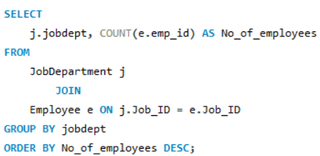
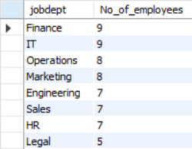
Key analysis questions
Which departments have the highest number of employees?

Slide 14
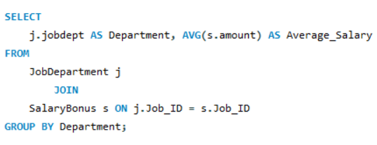
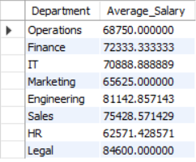
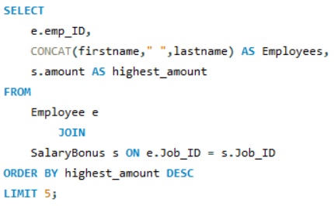
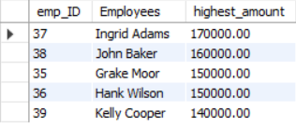
What is the average salary per department?
Who are the top 5 highest-paid employees?

Slide 15
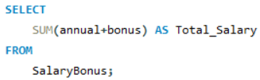

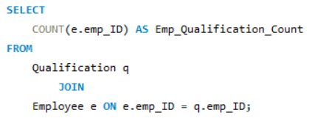

What is the total salary expenditure across the company?
How many employees have at least one qualification listed?

Slide 16
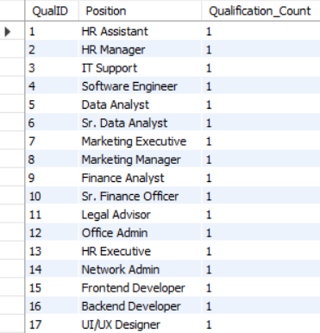
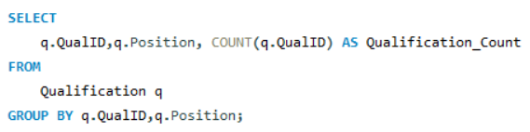
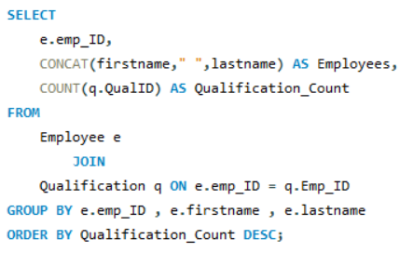
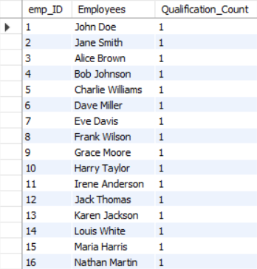
Which positions require the most qualifications?
Which employees have the highest number of qualifications?

Slide 17
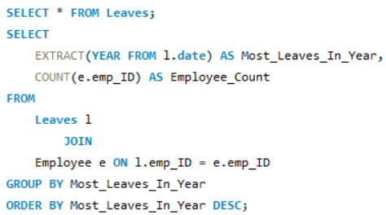

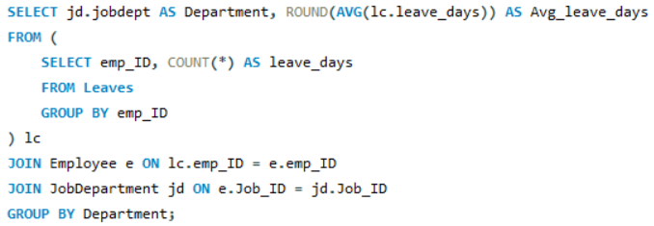
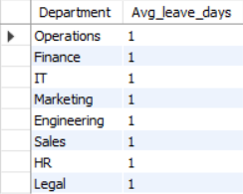
Which year had the most employees taking leaves?
What is the average number of leave days taken by its employees per department?

Slide 18
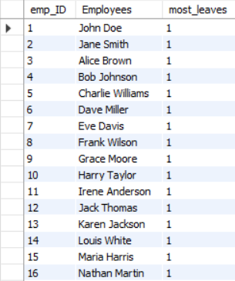
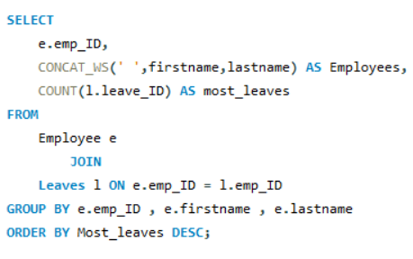
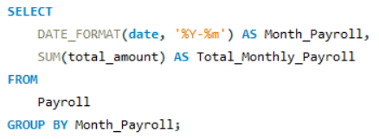
Which employees have taken the most leaves?
What is the total monthly payroll processed?

Slide 19
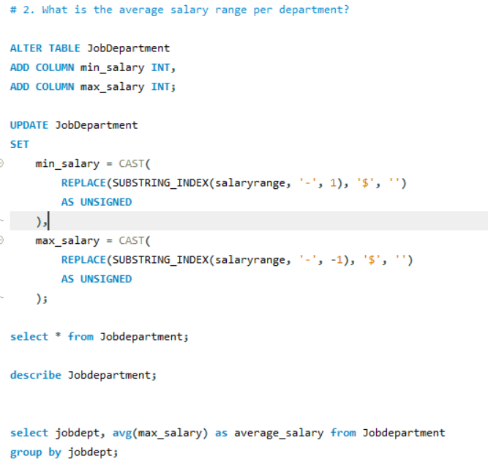
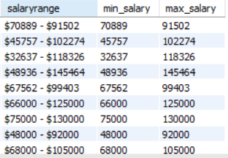
Challenges
Which is the average salary range per department ?

Slide 20
Final Business Insights
Centralized employee and payroll data enables faster, data-driven HR and management decisions.
Department-wise salary and bonus analysis helps identify high-cost roles and optimize budgets.
Integrated leave and payroll data reveals attendance patterns impacting productivity and compensation.
Qualification and skill analysis highlights workforce gaps, supporting training and hiring strategies.

Slide 21
Conclusion
The Employee Management System efficiently manages employee, job, payroll, qualification, and leave data using a relational database. It ensures data accuracy and consistency through well-defined relationships and constraints. The system simplifies payroll processing and leave management through integrated data handling.
Centralized data storage improves HR efficiency and supports informed decision-making. Overall, the project demonstrates the value of database-driven solutions in HR management.

Slide 22


Slide 23

ANY QUERIES

